Slide 1
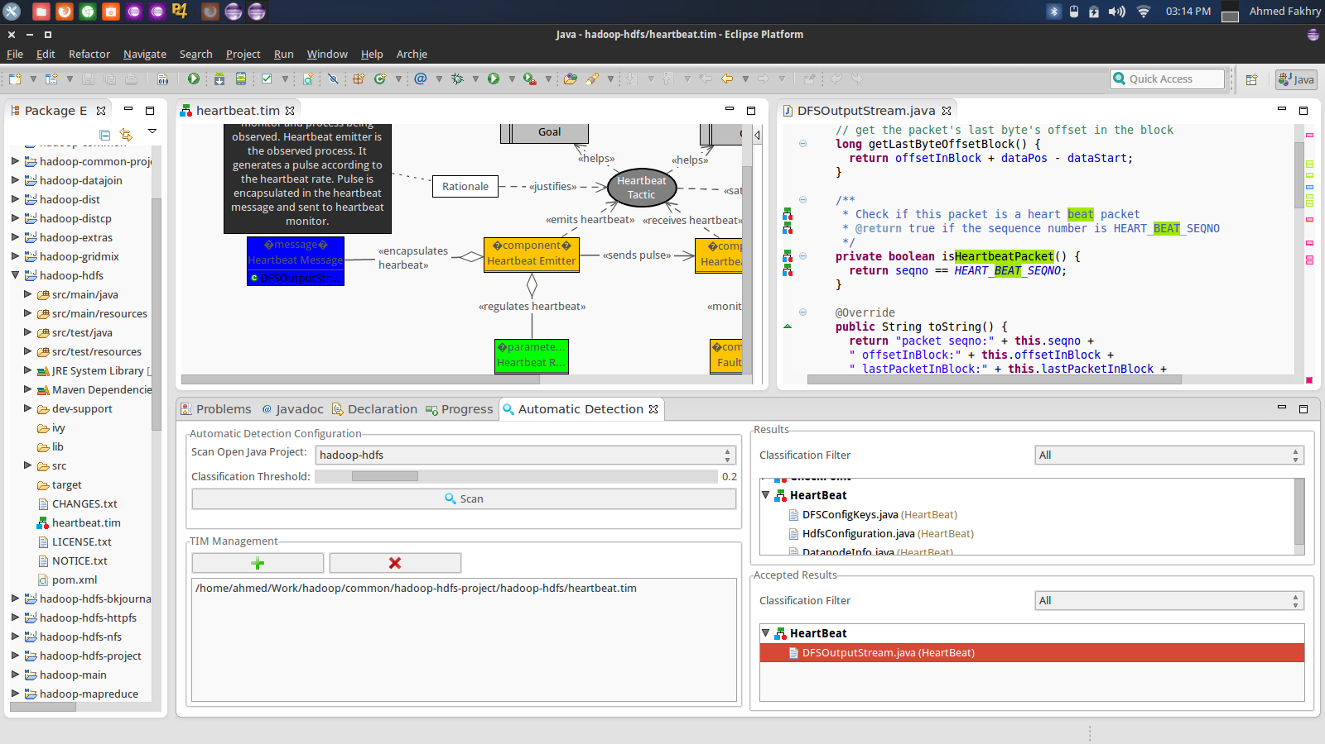
❍ Code Viewer
 Tactic Visualization Panel
● Classified Code Snippets
 Tactic Classifier

